Slide 1

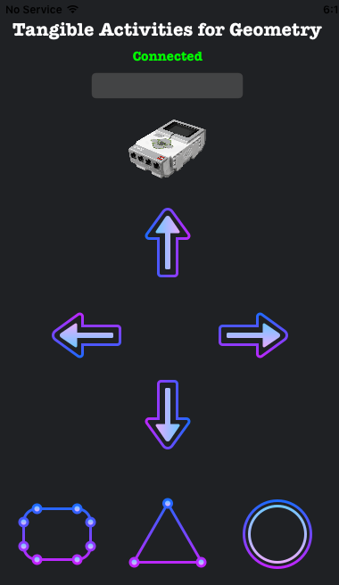
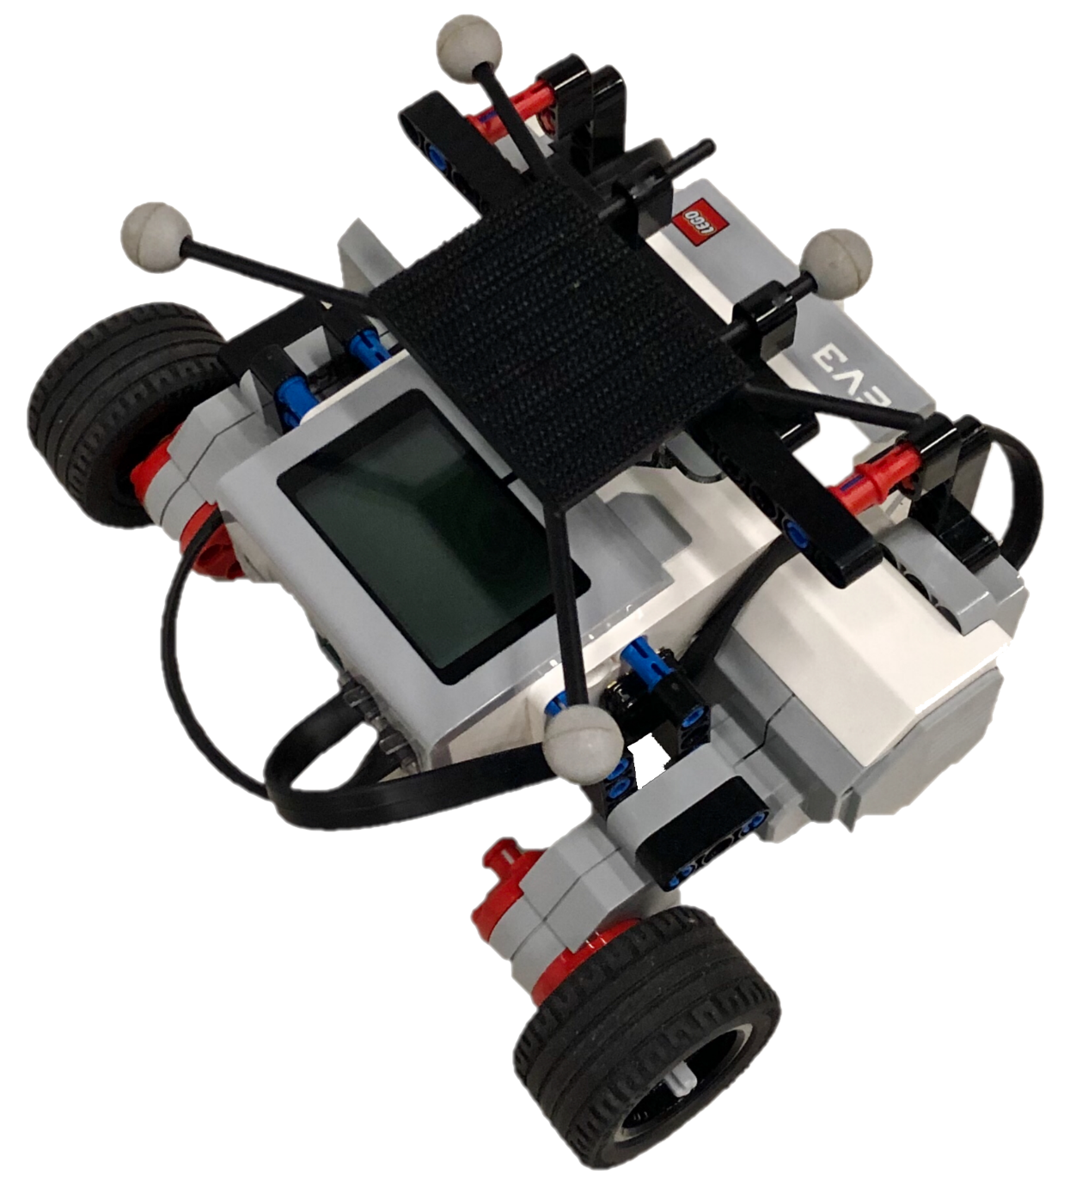
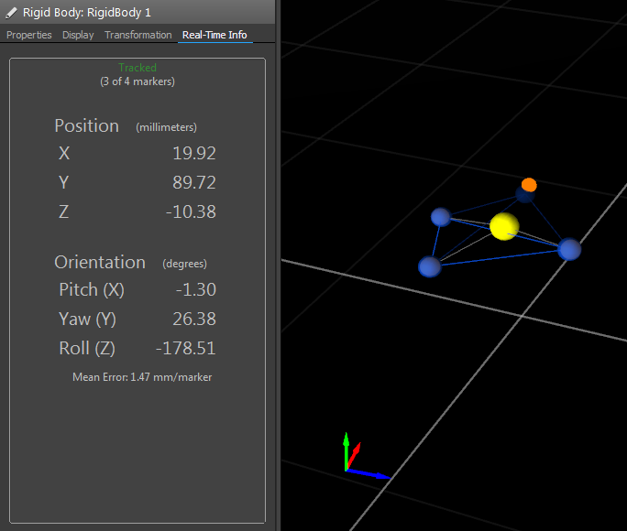
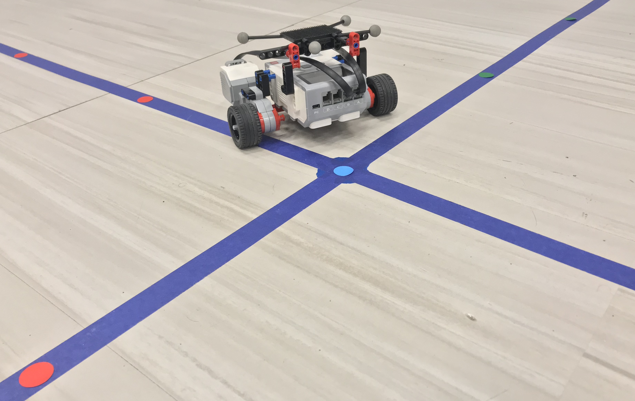
Tangible Activity for Geometry
Kevin Chen¹, Sicong Liu²
1. NYU Tandon School of Engineering 2. NYU Tandon School of Engineering
Abstract
Tangible Activities for Geometry (TAG) aims to assist middle school students to learn the fundamentals of geometry by interacting with a teachable robot. TAG is programmed using Python on the Lego Mindstorms (Linux) and utilizes positional data from a motion capture system to support geometric movements. Students interact with TAG through an iOS app that provides verbal feedback that resembles an interaction between the student’s peers instead of a teacher.
Attribution theory demonstrates that with teachable agents like TAG, students have peer-like interactions with robots therefore if a student fails at a math problem, they don’t feel dismal because the robot provides peer-like feedback contrasted by interactions with a teacher or professor [2].
Methodology
With OptiTrack, EV3 robot, and iOS interface technologies integrated into this project, the Message Queuing Telemetry Transport (MQTT) server acts at the bridge to connect the components together. Software implements Python to gather data from the OptiTrack to send to the MQTT message broker which is analyzed on the iOS application and sends continuous feedback to the robot. For instance, if students moved the robot to (4, 2), the robot would receive commands from the iOS app to rotate to 0° orientation and drive until it reaches 4 in the positive x-axis, then the robot rotates to 90° orientation and drive until it reaches 2 in the positive y-axis.
iOS App
MQTT Server
Figure 3: iOS Application
Figure 4: EV3 Robot
OptiTrack
EV3 Robot
Figure 1: OptiTrack Environment
Figure 2: OptiTrack Cameras
Figure 7: Feedback of TAG Design
Background
Sitting in the classroom isn’t always an effective method for students to learn abstract topics like geometry. However, students are more engaged while interacting with physical devices like robots. Robots are always a powerful tool for students in STEM learning, improving comprehension and improving confidence in their skills [1]. In this research project, the learning environment (a robot and motion-capture system) is developed as a teachable agent to help students learn simple geometry, as well as provide students with feedback. This research also explores students’ emotion responses to solving geometric problems to improve the learning experience. Known as attribution theory, students identify more easily with peers than teachers. When a student makes a mistake, he/she isn’t overwhelmed because it is interaction between peers.
Design and Environment
The project environment consists of the robot and the motion capture system. The robot contains four motion capture markers that are fixed horizontally near center of the robot. The OptiTrack is a multi-camera 3D motion tracking system integrated into the lab space to capture position and orientation. Nine high-definition cameras are fixed to ensure accurate measurement of the markers in any direction. On the ground, the two intersecting tapes mimics the x-axis and y-axis coordinate grid which allows the robot to conduct simple geometry problems in the standard grid taught in the classroom. This environment provides teachers with an easier method to communicate the lessons of geometry using the teachable robot to act as students’ peers are they work out geometric problems.
Figure 5: OptiTrack Data Stream
Figure 6: EV3 Robot on Coordinate Grid
Future Development
Next steps would be integrating sensors such as a brain computer interface to capture EEG to measure emotional responses such as engagement, anxiety, and enjoyment.
Works Cited
[1] V. A. Aleven and K. R. Koedinger. 2002. An effective metacognitive strategy: Learning by doing and explaining with a computer-based Cognitive Tutor. Cognitive science, 26(2), 147-179.
[2] W. Burleson, D. B. Harlow, K. J. Nilsen, K. Perlin, N. Freed, C. Jensen, B. Lahey, P. Lu, K. Muldner. 2018. Active Learning Environments with Robotic Tangibles: Childrens Physical and Virtual Spatial Programming Experiences. IEEE Transactions on Learning Technologies, 11(1), 96–106. https://doi.org/10.1109/TLT.2017.2724031
Acknowledgement
This work was generously funded by NYU Tandon School of Engineering’s Office of Undergraduate Academics and special thanks to NYU-X Lab: Winslow Burleson (PhD), Jeremy Rowe (EdD), Gustavo de Oliveira Almeida (PhD) for research guidance and support.

